Slide 1



LEARNING FROM DATA
Project Presentation
Enes Göktuğ Güneş - 2221251037
Enes Talha Koçyiğit - 2221251023

Slide 2

PROBLEM AND MOTIVATION
The Problem Definition
Context: Rapid growth of digital journalism leads to massive amounts of unstructured text data.
The Challenge: Manual categorization is time-consuming, expensive, and impractical at scale.
Objective: Develop an automated system to classify Turkish news articles into predefined categories (Politics, Sports, Technology, etc.).
Relevance: Essential for information retrieval, personalized recommendations, and digital archiving.
02

Slide 3
PROBLEM AND MOTIVATION
Motivation & Challanges
Why Turkish?
Agglutinative language structure (complex morphology) presents unique challenges for feature extraction.
Need for specialized preprocessing (stemming, stop-word removal).
Learning Goals:
Going beyond accuracy: Understanding generalization and overfitting.
Analyzing the Bias-Variance tradeoff in real-world data.
Comparing traditional Machine Learning vs. Neural Network approaches.
03

Slide 4
DATA COLLECTION APPROACH
Data Source:
Custom dataset created via Python web scraping.
Strict adherence to website Terms of Service.
Dataset Stats:
Size: 2,000+ labeled articles.
Classes: Multi-class distribution (Politics, Economy, Sports, etc.).
Preprocessing Steps:
Noise Removal: HTML tags, URLs, special characters.
Normalization: Lowercasing.
Tokenization & Stop-word removal (Turkish specific).
Stemming: Reducing words to roots to handle Turkish morphology.
04

Slide 5
METHODS COMPARISON
Feature Engineering Strategy
Bag-of-Words (BoW):
Baseline frequency-based representation.
TF-IDF (Term Frequency-Inverse Document Frequency):
Weighted representation to highlight discriminative terms.
Proved effective for reducing the impact of common words.
Custom Features:
Domain-specific features like document length and keyword density.
05

Slide 6
METHODS COMPARISON
Models & Training Strategy
Category A: Linear Models
Logistic Regression & Linear SVM: Strong baselines for high-dimensional sparse text.
High bias, low variance characteristics.
Category B: Deep Learning
Multi-Layer Perceptron (MLP): Utilized to capture non-linear relationships.
Higher expressive power but increased risk of overfitting.
Training Protocol:
Split: Train / Validation / Test separation.
Validation: 5-Fold Cross-Validation for hyperparameter tuning.
Metric: Optimization based on Log-Loss and F1-Score.
06

Slide 7
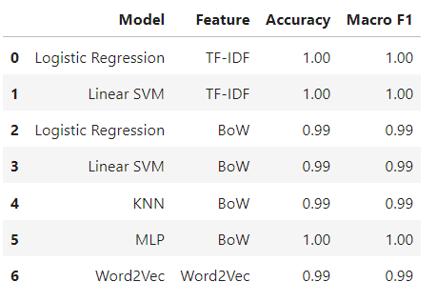
KEY RESULTS
Performance Overwiev
Model Comparison:
TF-IDF features consistently outperformed simple BoW.
Linear SVM achieved the best balance of accuracy and computational efficiency.
MLP showed competitive results but required more tuning for regularization.
07

Slide 8
KEY RESULTS
Error Analysis & Challenges
Ambiguity:
Frequent confusion between Politics and Economy classes.
Reason: Shared vocabulary
Class Imbalance:
Mild imbalance affected minority classes; handled via Weighted F1-Score evaluation.
Visual Inspection:
Misclassified examples often contained mixed topics
08

Slide 9
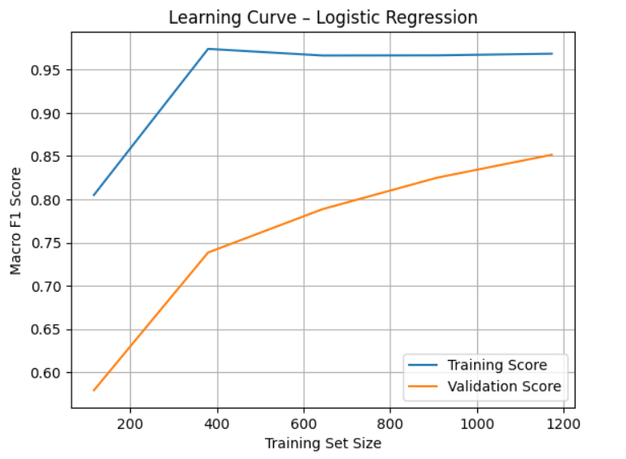
KEY RESULTS
Overfitting & Regularization
Bias-Variance Analysis:
Linear models exhibited higher stability (lower variance).
Neural Networks showed initial overfitting.
Mitigation Strategies:
L2 Regularization: Applied to weights.
Dropout: Used in MLP layers.
Early Stopping: Prevented training on noise.
09

Slide 10
CONCLUSION
Key Insight:
Feature representation (TF-IDF vs BoW) had a bigger impact on performance than algorithm choice.
The dataset exhibited strong lexical separability.
Lessons Learned:
Preprocessing is critical for agglutinative languages like Turkish.
Rigorous evaluation (beyond simple accuracy) is needed for real-world reliability.
Future Work:
Implement Transformer-based models (BERT/T5).
Expand dataset size and diversity.
09

